Slide 1
UNDERSTANDING CO2 EMISSIONS: CAUSES, IMPACTS, AND SOLUTIONS

Slide 2

Introduction to CO2 Emissions
CO2 emissions are a signiﬁcant contributor to climate change. Understanding their causes, impacts, and potential solutions is crucial for a sustainable future. This presentation will explore these aspects in detail, highlighting the importance of reducing our carbon footprint to protect the planet.

Slide 3
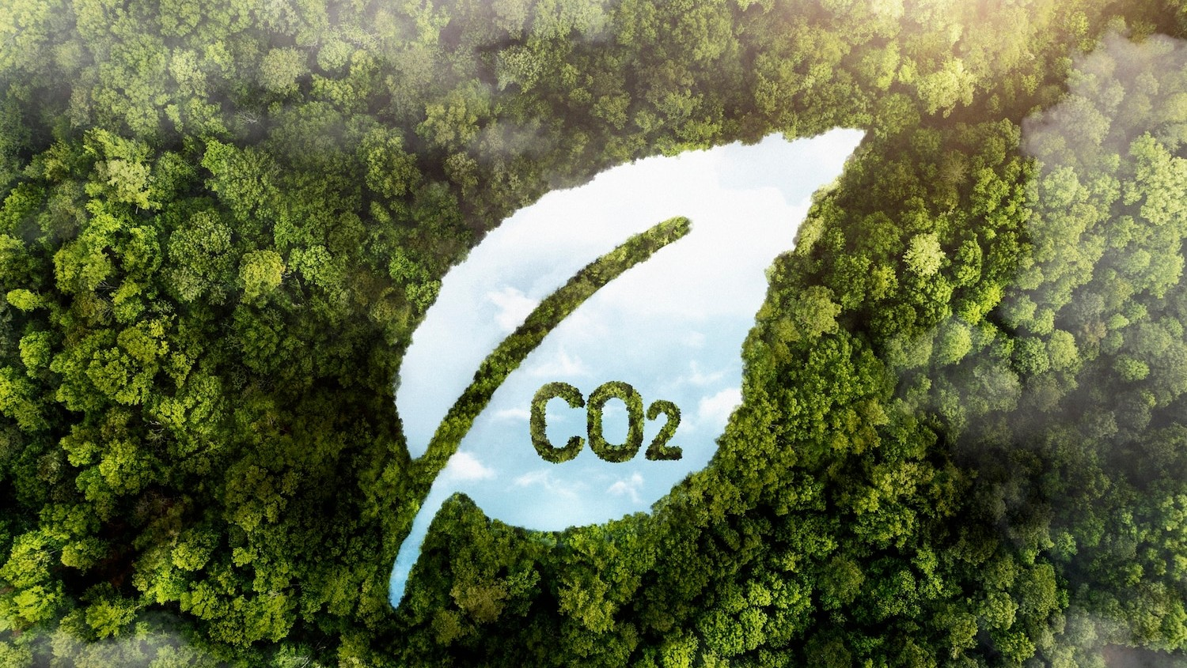
What is CO2?
Carbon dioxide (CO2) is a colorless gas produced by the respiration of animals and plants, as well as through combustion of fossil fuels. It plays a vital role in the carbon cycle, but excessive emissions can lead to severe environmental issues, including global warming.

Slide 4
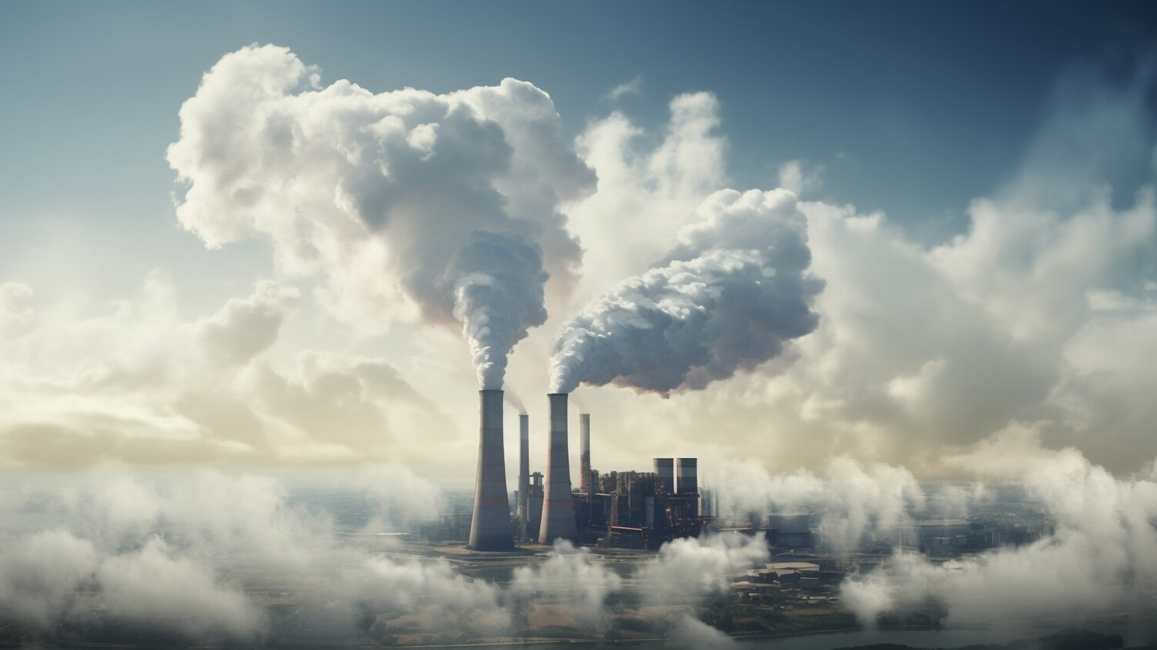
Main Causes of CO2 Emissions
The primary sources of CO2 emissions include burning fossil fuels, deforestation, and industrial processes. The energy sector, transportation, and agriculture contribute signiﬁcantly to these emissions, highlighting the need for sustainable practices to mitigate their impact on the environment.

Slide 5

IMPACT ON CLIMATE CHANGE
Increased CO2 emissions contribute to climate change, leading to severe weather events, rising sea levels, and loss of biodiversity. These changes threaten ecosystems and human health, making it imperative to address the root causes of emissions to ensure a stable climate for future generations.

Slide 6

HEALTH IMPACTS OF CO2
High levels of CO2 emissions can lead to respiratory problems and other health issues. Poor air quality affects vulnerable populations, including children and the elderly. Reducing emissions is essential not only for the environment but also for improving public health and quality of life.

Slide 7

ECONOMIC CONSEQUENCES
The economic impact of CO2 emissions is profound, affecting agriculture, infrastructure, and healthcare costs. Climate change can disrupt food production and increase disaster recovery expenses. Investing in renewable energy and sustainable practices can help mitigate these economic challenges.

Slide 8

GLOBAL CO2 EMISSION TRENDS
Globally, CO2 emissions have been rising steadily, with signiﬁcant contributions from industrialized nations.
Understanding these trends is crucial for setting emission reduction targets.
Tracking progress can help nations work
towards a more sustainable future and meet international agreements like the Paris Accord.

Slide 9

RENEWABLE ENERGY SOLUTIONS
Transitioning to renewable energy sources such as solar, wind, and hydroelectric power can signiﬁcantly reduce CO2 emissions. These sustainable alternatives not only minimize carbon footprints but also promote energy independence and job creation in new sectors.

Slide 10

CARBON CAPTURE TECHNOLOGIES
Carbon capture and storage (CCS) technologies are emerging as a viable solution to reduce CO2 emissions from industrial sources.
By capturing carbon before it enters the atmosphere, we can mitigate the effects of climate change while maintaining industrial productivity.

Slide 11

POLICY AND REGULATION
Effective policies and regulations are essential for reducing CO2 emissions.
Governments can implement measures such as carbon pricing, emissions trading systems, and incentives for renewable energy adoption to encourage sustainable practices across all sectors.

Slide 12

COMMUNITY INITIATIVES
Local communities play a vital role in reducing CO2 emissions through initiatives like tree planting, promoting public transport, and supporting local farms. Grassroots movements can lead to signiﬁcant changes and inspire larger societal shifts towards sustainability.

Slide 13
CONCLUSION AND CALL TO ACTION
Understanding CO2 emissions is crucial for addressing climate change. By recognizing their causes and impacts, and implementing effective solutions, we can collectively work towards a more sustainable future. Every action counts, and together, we can make a difference.

Slide 14

Thanks!
Do you have any questions? prashantsingh89627@gmail.com
+91 89627 81887
Github

